Slide 1

Major Crimes in NYC Public Schools
Rachel Ward – Computational Math & Statistics Midterm Project

Slide 2
Data source
Dataset on crimes committed in Public Schools in NYC from 2013 – 2016. Contains information on:
Borough
Building
Major Crimes
Violent Crimes
Council District
Etc.
Sourced from NYC Open Data
Overall sample size for 2013-2014 school year: 345

Slide 3

Research Question
Is there a difference in average number of major crimes committed in NYC Public Schools amongst the 5 boroughs?

Slide 4
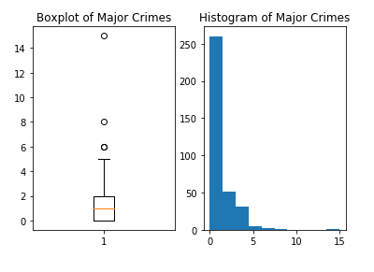
Exploratory data analysis
To achieve independence, I had to limit the data set to one school year (2013 – 2014)
The distribution of major crimes per building is skewed right (as shown in the diagrams)
This indicates there are:
Outliers – a few buildings with a very high number of major crimes

Slide 5
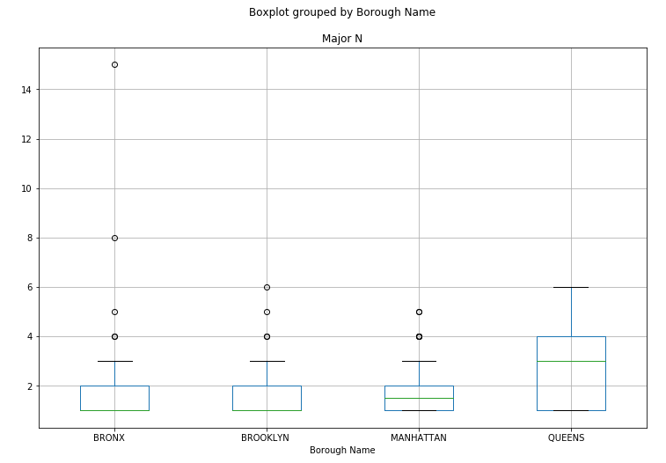
Hypothesis test
H0: There is no difference in average number of major crimes amongst the 5 boroughs.
Ha: There is a difference in average number of crimes amongst at least one borough.
From the boxplots, it seems Queens might have a higher average.
I had to remove Staten Island because there were less than 5 samples.

Slide 6
Statistical analysis
Somewhat surprisingly, my ANOVA generated a p-value of .36.
This is higher than the standard threshold of .05 and means there is insufficient evidence to reject the null hypothesis.
We do not have conclusive proof that there is a difference in average crimes amongst the boroughs.

Slide 7

Conclusions
There was not enough data present from Staten Island to include that borough in this analysis. It would be interesting to see if having additional data would make a difference. I’m also curious as to why the NYPD did not publish those results in this dataset.
I would also be curious to see if different school years yielded different results.
Another way to approach this analysis would have been to focus on a few schools and do a paired t-test over 2 years to see if there was a change in results. This would be useful for schools that had implemented new security measures to see if the measures worked.

